Slide 1

Everyday 401(k) Onboarding Guide
Disclaimer text: For Institutional / Wholesale / Professional Clients and Qualified Investors only—Not for retail use or distribution

Slide 2
Welcome to J.P. Morgan Everyday 401(k)!
TABLE OF CONTENTS
3 - 6 Phase 1: Initial Onboarding / Welcome Call
Platform registration
Digital onboarding questionnaire
6-16 Phase 2: Kickoff Meeting Deck
Scheduling your kickoff call
Kickoff meeting agenda
Plan features discussion
Payroll and J.P. Morgan platform details
Responsibility for a successful implementations
How we’ll work together
Your J.P. Morgan Team
17-22 Phase 3: Plan and Payroll Setup
Plan documents review/approval
Payroll partners integration and roadmap
Platform walkthrough and payroll demo
23-24 Phase 4: Prepare for plan start date
Invite reminder and eligibility review
Employee enrollment
25-26 Phase 5: Onboarding complete
Payroll reminder
Successful payroll processing
Handoff to ongoing client service team
Let’s get started with Phase 1 of your onboarding journey that includes:
Platform registration
Onboarding task tracker questionnaire topic prep
Launching and completing your task tracker questionnaire
J.P. Morgan Welcome Call
For your convenience, we’ve embedded links to our help center where applicable throughout this guide to link you directly to pertinent help center content and video tutorials.. Just click on the help center graphic (as provided in the lower right panel of this page) to access our help center.
Upon completion of your platform registration, you’ll receive a Welcome Email from your dedicated Implementation Manager (within 3 business days) to schedule a J.P. Morgan Welcome Call In the interim, we highly recommend that you complete your onboarding task tracker questionnaire.
Please note that your dedicated Implementation Manager will be your day-to-day contact assisting and guiding you through Phases 2-5 of your onboarding plan journeys.
Your J.P. Morgan Client Onboarding Team

Slide 3





Client Onboarding Journey
Startup and Conversion Plans
PHASE 1
Employer Initial Setup
PHASE 2
Kickoff Meeting
PHASE 3
Plan & Payroll Setup
PHASE 4
Prepare for Plan Start Date
PHASE 5
Onboarding Complete

Slide 4
Phase 1- Employer Initial Setup
Employer: Digital Onboarding Topic Preparation
Company & Plan Administration Information
Payroll Setup & Payment Information
Participant Census Data
Legal entity name
Formation information
Company ownership
Authorized signer
Communication/Access
Current payroll system
Pay periods
Payroll manager
First contributions
Funding and bank information
Participant details
Participant census file
Participant file upload
Participant file validation

Slide 5
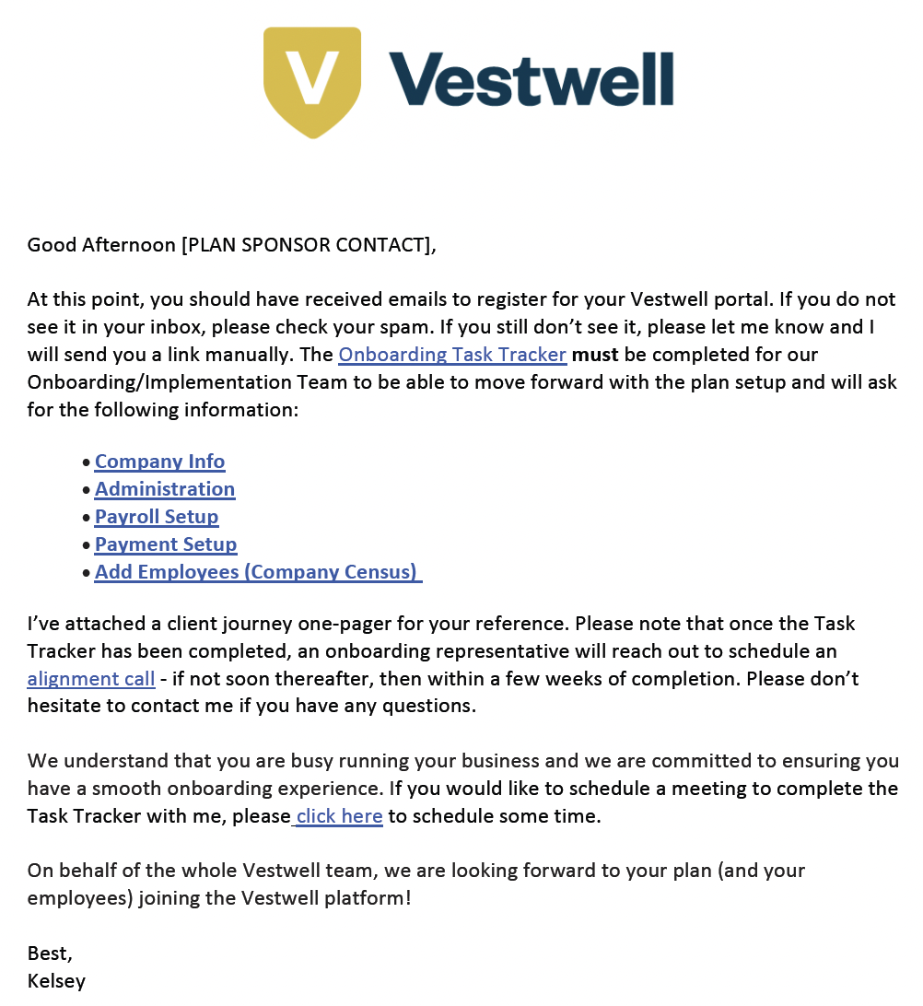
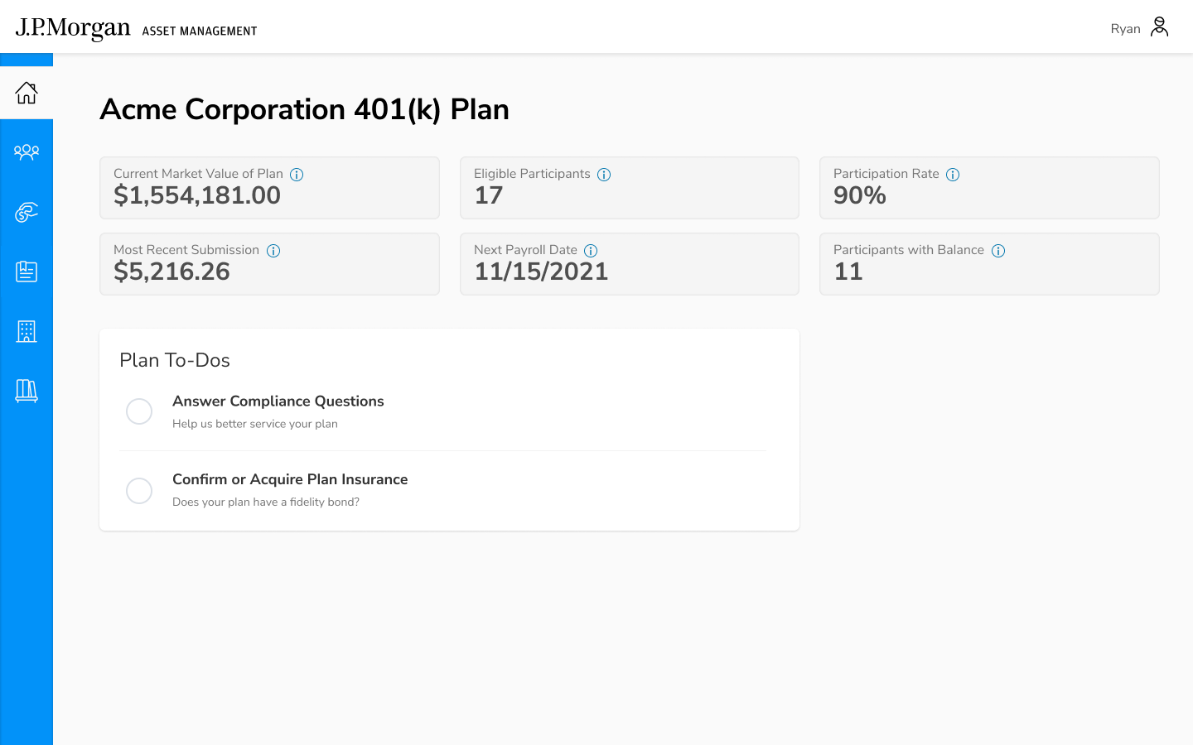
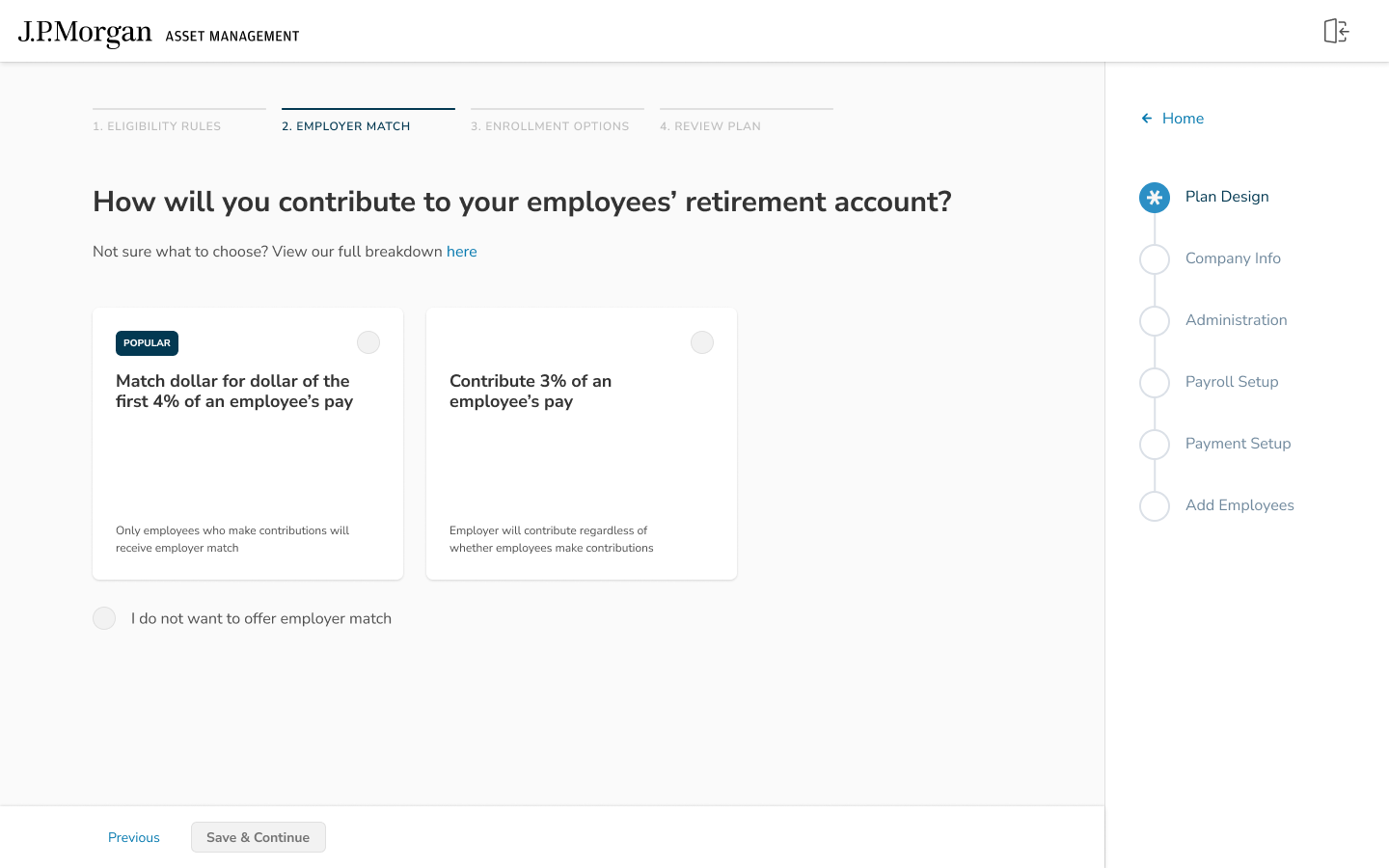

Phase 1- Employer Initial Setup
Employer: Digital Platform Registration
1
2
3
Registration Email
Click registration email link to get started
Platform Registration Page
Register for the platform
Digital Onboarding Portal
Complete onboarding questionnaire

Slide 6
Client Onboarding Journey
Startup and Conversion Plans
PHASE 1
Employer Initial Setup
PHASE 2
Kickoff Meeting
PHASE 3
Plan & Payroll Setup
PHASE 4
Prepare for Plan Start Date
PHASE 5
Onboarding Complete

Slide 7
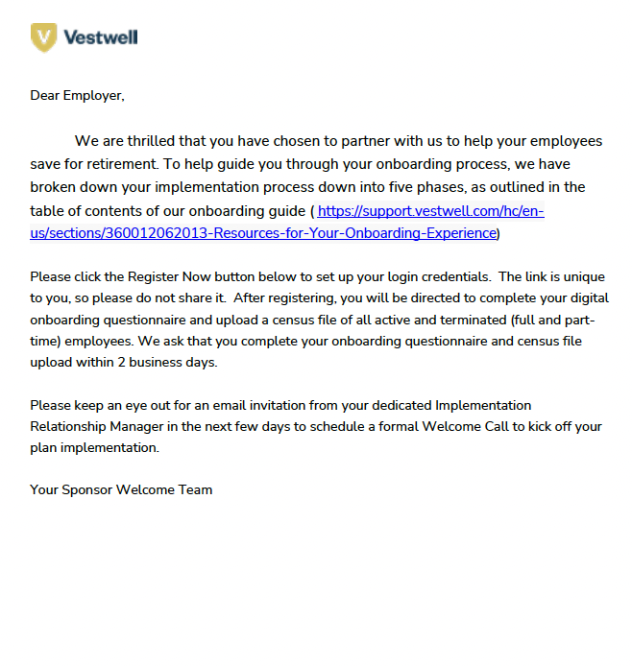
Phase 2- Kickoff Meeting
Employer: Scheduling Your Implementations Kickoff Meeting
1
2
3
Onboarding Welcome Email
Click on Implementation Manager’s scheduling link in the email
Schedule Kickoff Meeting
Consider attendee availability when selecting a meeting time
Suggested Plan Sponsor Meeting Attendees:
Plan Sponsor
Plan Sponsor administrators
Advisor if applicable
Payroll Manager
Meeting Presentation
Review the kickoff deck prior to the
meeting
Kickoff Meeting Agenda:
Plan Details
Payroll Integration
Proposed Implementation Timing
How We’ll Work Together
Your J.P. Morgan Team

Slide 8
Phase 2- Kickoff Meeting
Kickoff Meeting Agenda
1 Plan Features
2 Payroll & J.P. Morgan Platform Details
3 Key Responsibilities for Successful Implementation
4 How We Will Work Together
5 Your J.P. Morgan Team

Slide 9
Phase 2- Kickoff Meeting
Plan Feature Discussion
Joining the Plan
Age
No age requirement
Minimum age requirement
Service
No service requirement
Service requirement options
Entry
Entry A
Entry B
Exclusions
No exclusions
Exclusion options
Employee Contributions
Deferral Type
Pre-tax and Roth
Pre-tax only
Deferral Amount
Percentage and Dollar
Percentage only
Auto Enroll
No auto enroll
Select auto enroll rate
Auto Escalate
No auto escalate
Select % per year and cap

Slide 10
Phase 2- Kickoff Meeting
Plan Feature Discussion
Company Contributions
Safe Harbor
No safe harbor
Safe harbor options
Match
None
Discretionary
Profit Sharing
None
Profit sharing options
Vesting & Distributions
Vesting
100% immediate
Vesting schedule options
Hardship Withdrawals
All accounts
Deferrals only
Partial Distributions at Termination
No
Yes
Loans
Loan options

Slide 11
Phase 2- Kickoff Meeting
Payroll & J.P. Morgan Platform Details
Kickoff Call:
Payroll setup and integration discussion
Payroll Setup & Contributions
Implementation Phase: Connect with your payroll team to set up deduction codes
Payroll Provider:
Pay Dates:
Pay Schedule:
Pay Groups:
Funding Confirmation:
1st Payroll:
J.P. Morgan portal
submission/upload for
most clients*
2nd and Future Payrolls:
J.P. Morgan portal submission, Non-Integrated, 360 or 180 Integration
*Some payroll providers many offer integration with the 1st payroll

Slide 12





Phase 2- Kickoff Meeting
Transferring Your Plan to J.P. Morgan
J.P. Morgan prepares conversion letter & provides instructions
Prior provider and J.P. Morgan establish conversion timeline
You complete the letter and follow instructions for notifying current provider
J.P. Morgan communicates timeline to you
You complete all forms and instructions provided to you by your prior provider

Slide 13
Phase 2- Kickoff Meeting
Key Responsibilities for Successful Implementation
Employee Information
Plan Documents
Payroll Integration
Onboarding Timeline
Provide Complete Data
Sign Plan Documents
Integrate With Payroll
Refer To Your Timeline
Census information for all employees (even those who are not yet eligible or participating) and terminated participants with a balance (for conversion plans) must be provided to J.P. Morgan.
If you are using an hours-based eligibility/vesting, you will need to provide YTD hours worked and prior year hours worked - even for salaried employees
J.P. Morgan’s technology will calculate eligibility for you based on your plan design!
Review and sign your plan documents within 3 business days of receipt.
All documents must be executed no later than 14 days prior to your first payroll with J.P. Morgan or your plan live date will be delayed.
If you have a payroll integration, please review and take action to kick off the integration within 3 business days.
The first step for most payroll integrations requires you to provide access or complete an integration request with your payroll system.
Your timeline will include action items and deadlines

Slide 14
Phase 2- Kickoff Meeting
Key Information
Automatic Enrollment
Blackout Notice
Deferral Amounts and Balances
Understanding Automatic-Enrollment
Blackout
Reconciling Accounts
All Employees must opt-out if they do not want to save in the plan
After Employees register, they may select their savings rate and investments
90-day grace period for those that are auto-enrolled and who wish to withdraw funds without penalty (EACA)
Start date of the current plan assets entering a freeze from certain transactions with prior provider
Distributions, investment changes, loan requests, contributions
All funds remain in the current investments unless a change made prior to blackout start-date
Contributions to the plan will continue with J.P. Morgan
We require a list of all current plan participants, contribution rates, and current balances
Include any terminated employees with a balance in the plan

Slide 15
Phase 2- Kickoff Meeting
How We Will Work Together & Communicate Statuses
Consultative client
onboarding approach
Two-way, open communication between organizations
Dedicated Implementation Manager
Plan Design
Payroll Integrations Specialist
Client Success Manager
Clearly defined upfront contacts and time commitments between organizations
Clearly defined upfront risks and implementation mitigation tactics
Agreed upon deliverables milestones and time commitments
On-demand status updates: Implementation phase completion statuses
Bi-weekly updates: Bi-weekly high level schedule updates

Slide 16
Phase 2- Kickoff Meeting
Your J.P. Morgan Team
Dedicated Implementation Manager
Plan Design Manager
Implementation Operations Specialist
Payroll Integration Specialist
Platform Experience Manager
Ongoing Client Success Manager

Slide 17
Client Onboarding Journey
Startup and Conversion Plans
PHASE 1
Employer Initial Setup
PHASE 2
Kickoff Meeting
PHASE 3
Plan & Payroll Setup
PHASE 4
Prepare for Plan Start Date
PHASE 5
Onboarding Complete

Slide 18
Phase 3- Plan & Payroll Setup
Employer: Plan Document Review & Approval
Plan Design Details
Employee eligibility
Employee contributions
Company contributions
Vesting and distribution
Conversions: Prior Plan Review
Detailed review of prior plan documents
Plan Design Summary
Kickoff meeting follow up plan design summary*
Draft Plan Design Details
Employee eligibility
Employee contributions
Company contributions
Vesting and distribution
J.P. Morgan Plan Approval
Complete DocuSign review and approval
Final Plan Design Details
Employee eligibility
Employee contributions
Company contributions
Vesting and distribution
*Please note review and approval of the plan design specifications is required prior to drafting formal plan documents

Slide 19
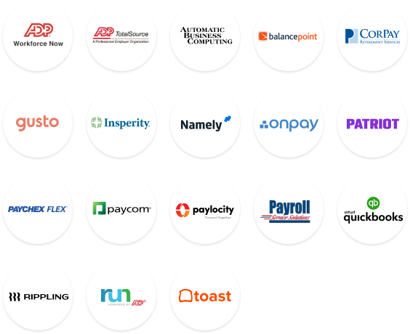


Phase 3- Plan & Payroll Setup
Payroll Partner Integration & Roadmap
Payroll Provider
Payroll Provider
BEFORE
AFTER
HR Admin
401(k) Provider
401(k) Provider
HR Admin
Deferral/Contribution Updates
Census & Payroll Data

Slide 20
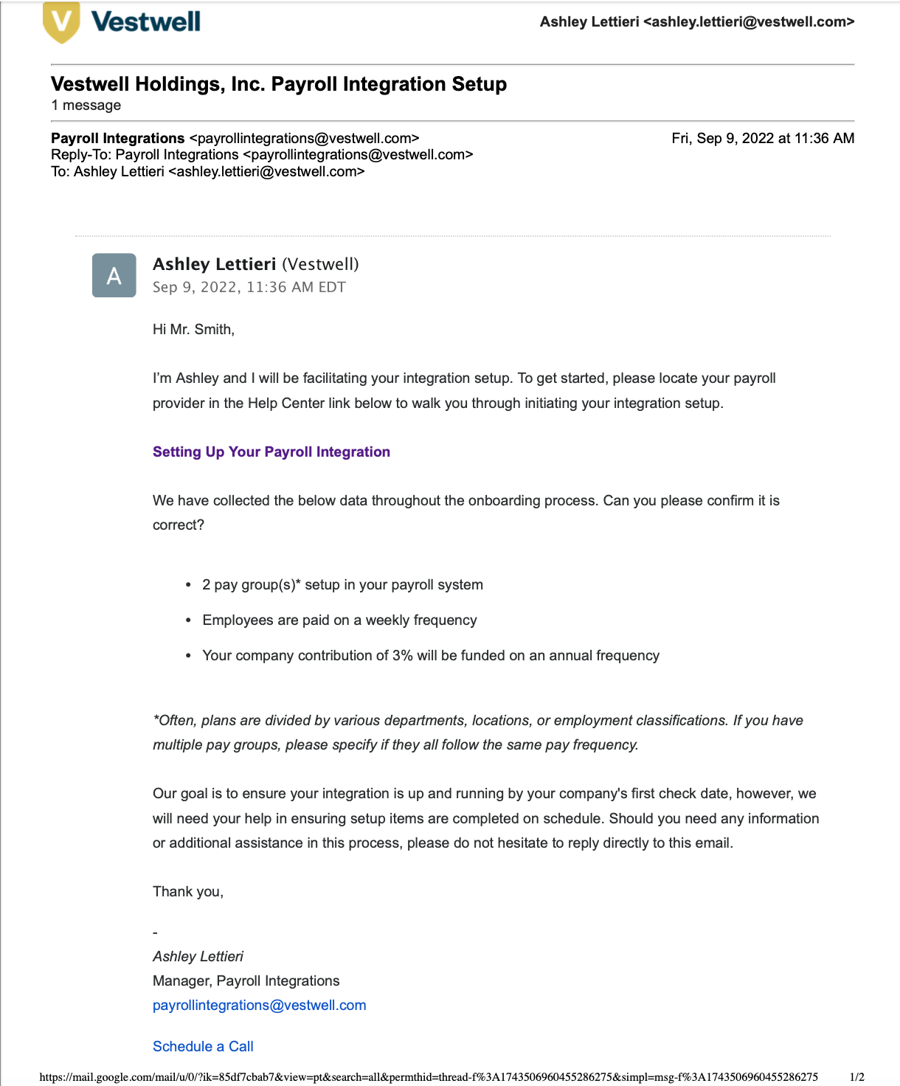
Phase 3- Plan & Payroll Setup
Employer: Payroll Integration & Setup
Payroll Integration Setup Email
Payroll Specialist designated
Initial Steps for Setup
Review integration setup materials
Verify payroll setup in J.P. Morgan
Provide payroll system access or contact payroll provider
Setup deduction codes and employer match
Payroll Integration Testing
Payroll Specialist will require a test file for each implementation
Feedback given directly to payroll provider
Confirm integration setup
Monitor first payroll submission

Slide 21
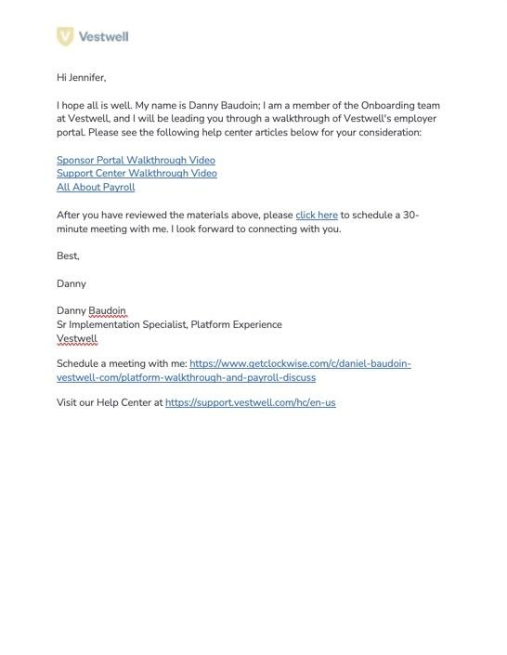
Phase 3- Plan & Payroll Setup
Employer: Plan Sponsor Platform & Payroll Walkthrough
Platform Walkthrough Invite
Platform Experience Specialist Assigned
Schedule Platform Walkthrough
Determine meeting attendees
Employer Meeting Attendees
Employer
Employer administrators
Advisor if applicable
Payroll Manager
1st Payroll/Integration Support
Prepare for first payroll integration
Meet Your J.P. Morgan Team
Platform Experience Specialist

Slide 22
Phase 3- Plan & Payroll Setup
Employer: Trust Services, Prior Recordkeeper Termination, Blackout Conversion Planning
J.P. Morgan Operations Team
Operations Specialist Assigned
Drafting of termination letter to prior record keeper
Blackout scheduling
Wire and transfer information
Reconciliation
Prior RK Termination
Prior recordkeeper contacts established
Employer Meeting Attendees
Termination letter sent to prior record keeper
Prior record keeper works with operations specialist to determine blackout scheduling
Prior record keeper works with operations specialist to schedule wire of assets and participant balance allocations needed for reconciliation
Blackout & Reconciliation
Management of blackout period
Blackout period notices are sent to participants
Divesting of participant assets occurs during the blackout period
Assets are transferred to J.P. Morgan via wire
Participant balance report is sent for fund investing and blackout period ends

Slide 23
Client Onboarding Journey
Startup and Conversion Plans
PHASE 1
Employer Initial Setup
PHASE 2
Kickoff Meeting
PHASE 3
Plan & Payroll Setup
PHASE 4
Prepare for Plan Start Date
PHASE 5
Onboarding Complete

Slide 24
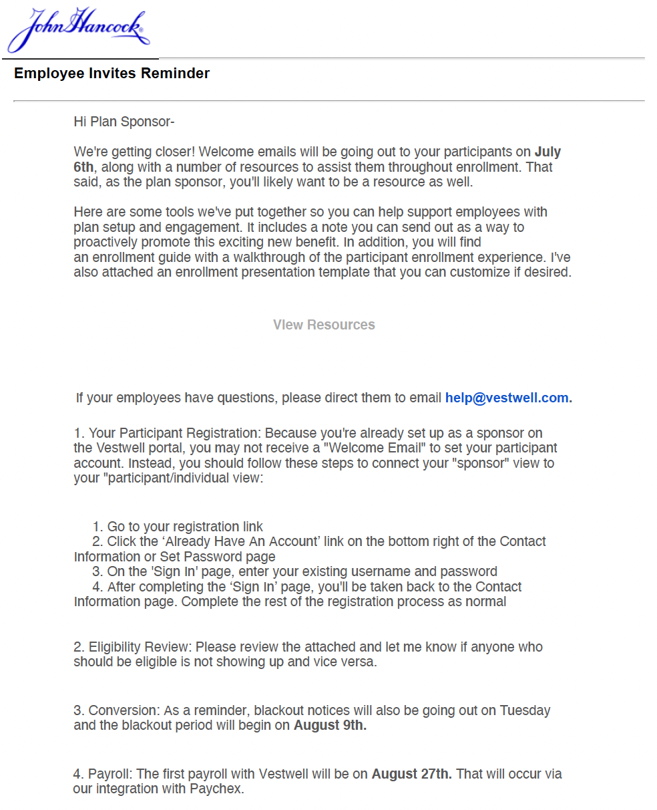
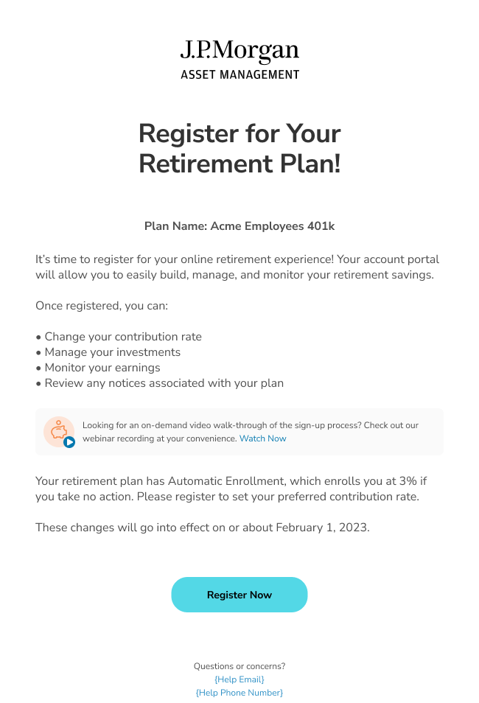
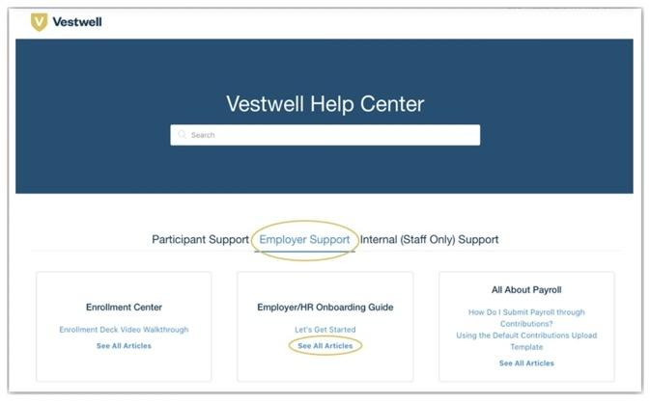
Phase 4- Prepare
Employer: Prepare for Plan Start Date
Employee Invite Reminder
Register for Retirement Plan
Help Center Support
J.P. Morgan Help Center

Slide 25
Client Onboarding Journey
Startup and Conversion Plans
PHASE 1
Employer Initial Setup
PHASE 2
Kickoff Meeting
PHASE 3
Plan & Payroll Setup
PHASE 4
Prepare for Plan Start Date
PHASE 5
Onboarding Complete

Slide 26
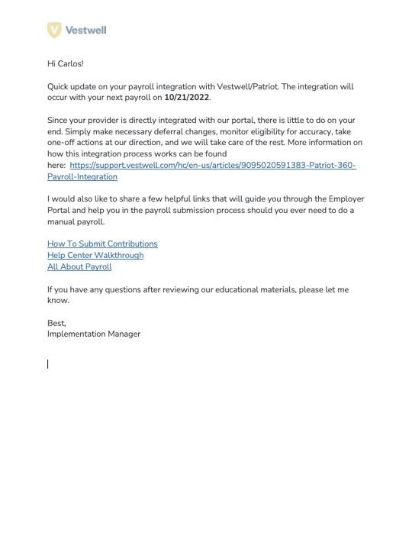
Phase 5- Onboarding Complete
Payroll Reminder
First Payroll Processing
Implementations Manager confirms
Email to confirm first payroll processed
Transition to Client Success
Implementations Manager transitions to CS
Email transition to Client Success occurs

Slide 27
Disclosures and other legal copy
This material has been prepared for informational and educational purposes only. It is not intended to provide, and should not be relied upon for investment, accounting, legal or tax advice. It is educational in nature and not designed to be recommendation for any specific investment product, strategy, plan feature or other purposes. The information is shown for illustrative purposes only and is not intended as an offer or solicitation with respect to the purchase or sale of any security.
Plan sponsors should reference JPMIH’s 408(b)(2) services and fee disclosure notice for more complete information, which is available on the plan sponsor portal for your plan. Additional fee information is available for participants on your plan’s J.P. Morgan Everyday 401(k) website.
Certain recordkeeping and related services for plans may be provided on behalf of JPMorgan Invest Holdings LLC (J.P. Morgan) or by Vestwell Holdings Inc.
Vestwell Holdings Inc. provides various fiduciary and non-fiduciary services on its proprietary recordkeeping platform to support tax-qualified retirement plans. To learn more about Vestwell Holdings Inc. and its services, please visit https://www.vestwell.com.
J.P. Morgan Asset Management is the brand name for the asset management business of JPMorgan Chase & Co and its affiliates worldwide.
If you are a person with a disability and need additional support in viewing the material, please call at 1-800-343-1113 for assistance.
Telephone calls and electronic communications may be monitored and/or recorded.
Personal data will be collected, stored and processed by J.P. Morgan Asset Management in accordance with our privacy policies at https://www.jpmorgan.com/privacy.
© 2023 JPMorgan Chase & Co.

Slide 28
Thank you

